Slide 1
Grafică asistată de calculator
Laborator – Grigore Ionuț

Slide 2
Laboratory 6
Generating
High-Resolution
Images with
Diffusion Models

Slide 3
Lab Overview
01
02
DDIM vs DDPM
Oxford Flowers dataset
Understand why DDIM needs only 50 steps instead of 1000, and what deterministic sampling means.
Download 8 000 color images and prepare them for training.
03
04
Attention in U-Net
Training the Model
Add self-attention layers so the model focuses on the most relevant pixel regions.
Train the 133 M-parameter U-Net on flowers dataset.
05
Interpolation
Blend two noise tensors to generate images that smoothly transition between two flowers.

Slide 4


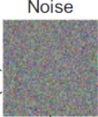
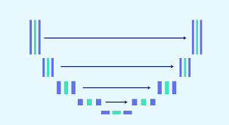
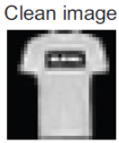


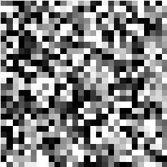

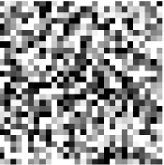
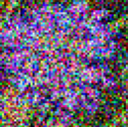


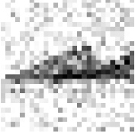
Context — What Problem Are We Solving?
Labs 4 & 5 — what we had
Lab 6 — what we want
▸ Grayscale 28×28 Fashion MNIST images
▸ Color 64×64 Oxford Flowers images
▸ Conditional generation with class labels
▸ Unconditional generation (no labels)
skip connections
skip connections
...
...
encoder
decoder
encoder
decoder
"sneaker"
▸ DDPM noise scheduler (stochastic, 1000 steps)
▸ DDIM scheduler (deterministic, only 50 steps)
...
...
1000 steps
50 steps

Slide 5
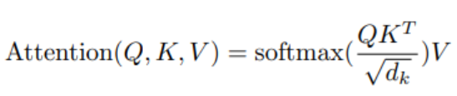
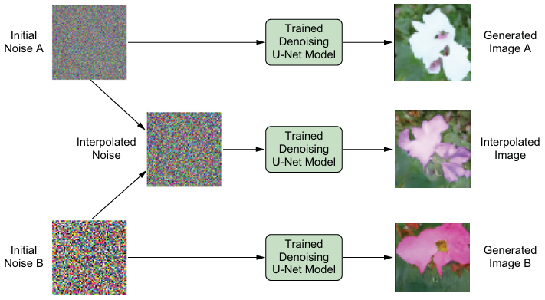
Context — What Problem Are We Solving?
Labs 4 & 5 — what we had
Lab 6 — what we want
▸ U-Net built from scratch (without attention)
▸ U-Net with attention
skip connections
skip connections
encoder
decoder
encoder
decoder
New in this lab: we also learn noise tensor interpolation — smoothly blending two noise seeds produces images that gradually transition from one flower to another.

Slide 6
Section 1
DDIM vs DDPM:
Faster, Deterministic Sampling

Slide 7
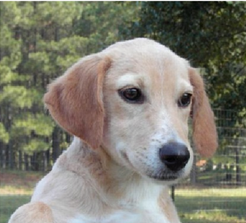
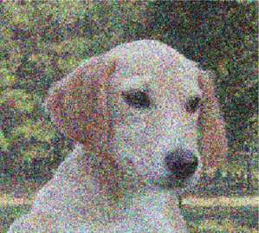
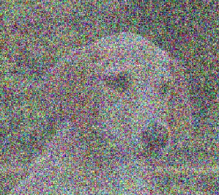







① Training: Forward Process — the model learns by destroying images
Real image
Slight noise added
More noise added
Pure random noise
+ noise →
+ noise →
+ noise →
…
…
-
, ~ 𝒩(0, I)
…we already know this…and it’s fine…

Slide 8

② Generation: Reverse Process — the trained model denoises step-by-step
Pure noise
Slight structure
Almost clear
Final image
– noise →
– noise →
– noise →
…
…
-
… but how do we obtain x_{t-1} given x_{t} ?
Predicted Noise
skip connections
encoder
decoder
-
Predicted Noise

Slide 10




DDPM Sampling Formula
DDIM Sampling Formula

Slide 11



DDPM Sampling Formula
1 000 full steps — slow at inference
Steps needed
DDIM Sampling Formula
50 steps — 20× faster with no quality loss

Slide 12



DDPM Sampling Formula
Steps needed
Stochastic — adds fresh random noise at every step
Different run = different image even with same seed
DDIM Sampling Formula
Deterministic — no random noise added during sampling if set to 0
Same noise seed always produces exactly the same image

Slide 13
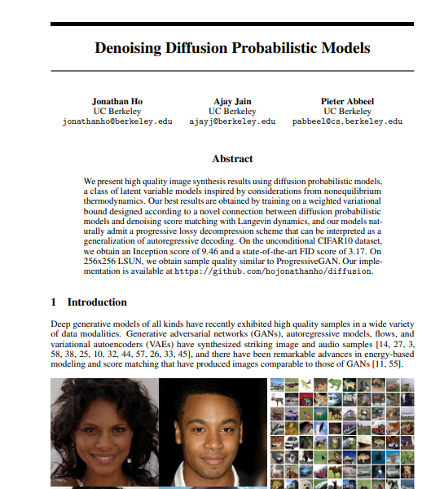
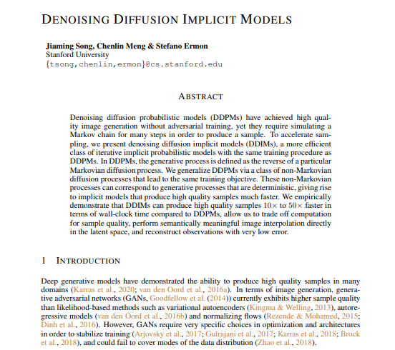


DDPM vs DDIM: Key Differences
DDPM — Labs 4 & 5
DDIM — Lab 6
Sampling type
Stochastic — adds fresh random noise at every step
Deterministic — no random noise added during sampling
Steps needed
1 000 full steps — slow at inference
50 steps — 20× faster with no quality loss
Markov property
Each step depends only on the previous (Markovian)
Can skip timesteps — non-Markovian shortcut
Reproducibility
Different run = different image even with same seed
Same noise seed always produces exactly the same image
June 2020
October 2020

Slide 14
Section 2
The Oxford Flowers Dataset

Slide 15
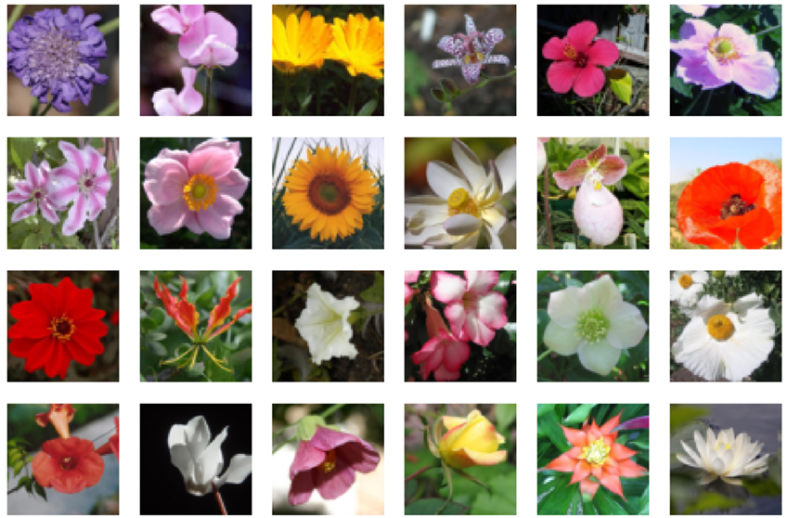
Oxford 102 Flowers Dataset
~8 000 color images of 102 flower categories, downloaded directly from Hugging Face.
~8 000
102
64 × 64
3
Training images
Flower categories
Image size (px)
Color channels (RGB)

Slide 16
Section 3
Building the U-Net with Attention

Slide 18
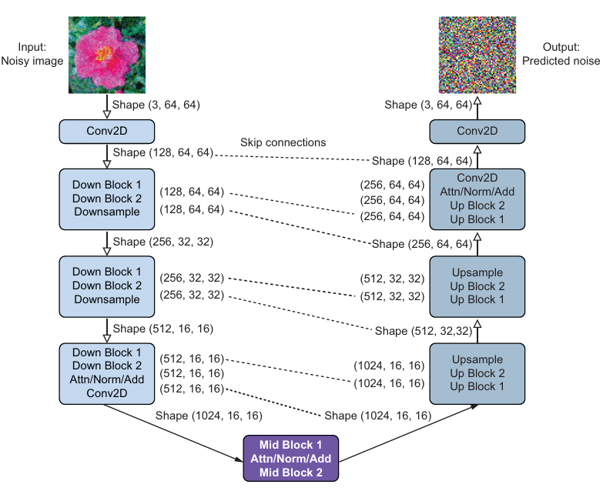

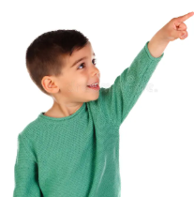

Slide 19
Self-Attention in the Denoising U-Net
The attention mechanism helps the U-Net focus on the most relevant pixel regions when denoising.
Why Attention & Model Size
The new U-Net is significantly larger (~133M parameters), allowing it to learn more complex and richer representations compared to previous laboratories.
However, the increased capacity and skip connections can introduce redundant or less relevant features.
The attention mechanism helps the model focus on the most important spatial regions while suppressing irrelevant information.
This leads to better feature selection and improved denoising performance.

Slide 20
Self-Attention in the Denoising U-Net
The attention mechanism helps the U-Net focus on the most relevant pixel regions when denoising.
class Attention(nn.Module):
def __init__(self, dim, heads=4, dim_head=32):
super().__init__()
self.scale = dim_head**-0.5
self.heads = heads
hidden_dim = dim_head * heads
self.to_qkv = nn.Conv2d(dim, hidden_dim * 3, 1, bias=False)
self.to_out = nn.Conv2d(hidden_dim, dim, 1)
def forward(self, x):
b, c, h, w = x.shape
qkv = self.to_qkv(x).chunk(3, dim=1)
q, k, v = map(
lambda t: rearrange(t, 'b (h c) x y -> b h c (x y)', h=self.heads),
qkv)
q = q * self.scale
sim = einsum('b h d i, b h d j -> b h i j', q, k)
attn = sim.softmax(dim=-1)
out = einsum('b h i j, b h d j -> b h i d', attn, v)
out = rearrange(out, 'b h (x y) d -> b (h d) x y', x=h, y=w)
return self.to_out(out)
NOTE:
This implementation is identical to standard multi-head attention used in other laboratories, with the only difference being the use of einsum notation.
The einsum notation provides a concise and expressive way to define tensor operations:
https://rockt.ai/2018/04/30/einsum

Slide 21
Try to focus on the big picture and not get lost in details

Slide 22
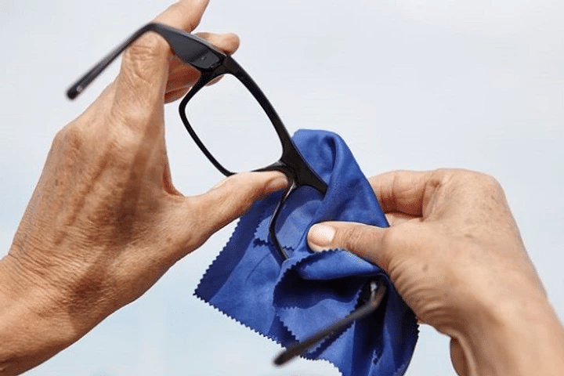
Self-Attention in the Denoising U-Net
class Attention(nn.Module):
def __init__(self, dim, heads=4, dim_head=32):
super().__init__()
self.scale = dim_head**-0.5
self.heads = heads
hidden_dim = dim_head * heads
self.to_qkv = nn.Conv2d(dim, hidden_dim * 3, 1, bias=False)
self.to_out = nn.Conv2d(hidden_dim, dim, 1)
def forward(self, x):
b, c, h, w = x.shape
qkv = self.to_qkv(x).chunk(3, dim=1)
q, k, v = map(
lambda t: rearrange(t, 'b (h c) x y -> b h c (x y)', h=self.heads),
qkv)
q = q * self.scale
sim = einsum('b h d i, b h d j -> b h i j', q, k)
attn = sim.softmax(dim=-1)
out = einsum('b h i j, b h d j -> b h i d', attn, v)
out = rearrange(out, 'b h (x y) d -> b (h d) x y', x=h, y=w)
return self.to_out(out)
class Attention(nn.Module):
...

Slide 23
Section 4
Training the
Diffusion Model

Slide 24
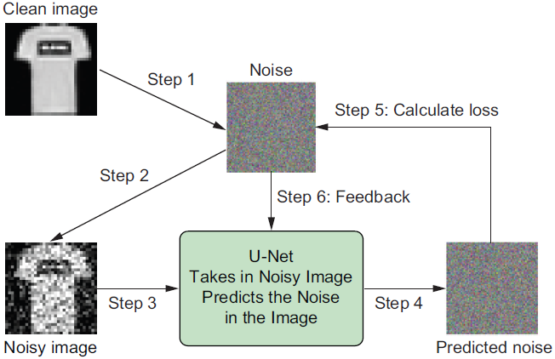

Slide 25
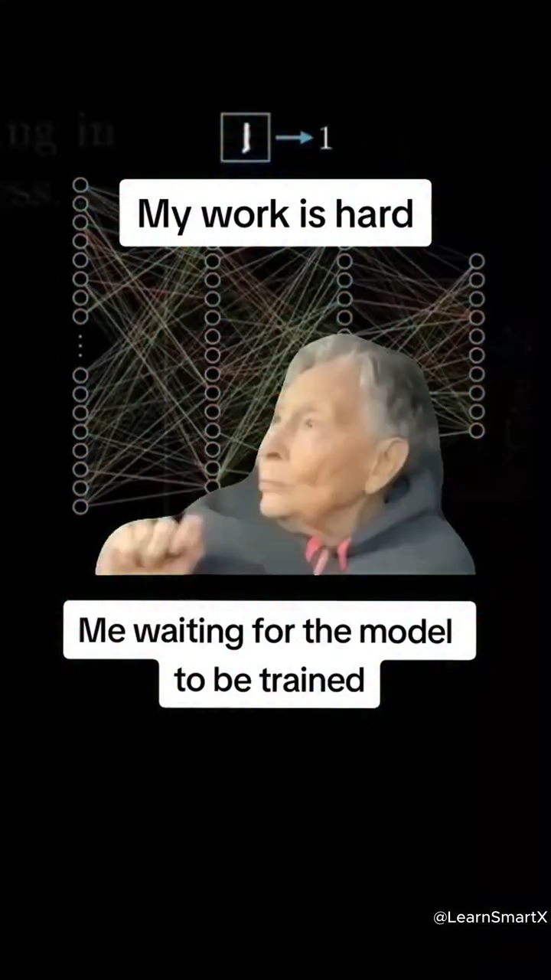
4.3 — Training the Denoising U-Net
optimizer=torch.optim.AdamW(model.parameters(), lr=0.0001,
betas=(0.95,0.999), weight_decay=0.00001, eps=1e-8)
lr_scheduler=get_scheduler("cosine", optimizer=optimizer,
num_warmup_steps=300, num_training_steps=(len(train_dataloader) * 100))
for epoch in range(1):
model.train()
tloss = 0
print(f"start epoch {epoch}")
for step, batch in enumerate(train_dataloader):
clean_images = batch["input"].to(device)*2-1
nums = clean_images.shape[0]
noise = torch.randn(clean_images.shape).to(device)
timesteps = torch.randint(0, noise_scheduler.num_train_timesteps,
(nums, ), device=device).long()
# Step 1: corrupt the image
noisy_images = noise_scheduler.add_noise(clean_images, noise, timesteps)
# Step 2: ask U-Net to predict the noise
noise_pred = model(noisy_images, timesteps)["sample"]
# Step 3: L1 loss between predicted and actual noise
loss = torch.nn.functional.l1_loss(noise_pred, noise)
loss.backward()
optimizer.step()
lr_scheduler.step()
optimizer.zero_grad()
tloss += loss.detach().item()
if step%100==0:
print(f"step {step}, average loss {tloss/(step+1)}")
torch.save(model.state_dict(),'files/diffusion.pth')

Slide 26
Section 5
Image Generation
and Noise Interpolation

Slide 27
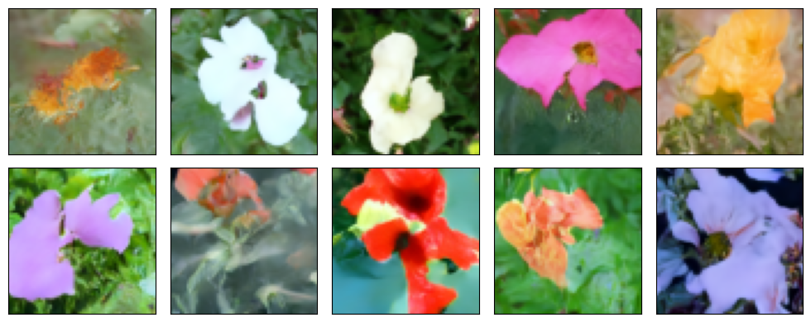
Generating Flower Images with DDIM
50 inference steps, starting from pure noise, producing a unique flower determined by the noise seed.
...
50 steps

Slide 28
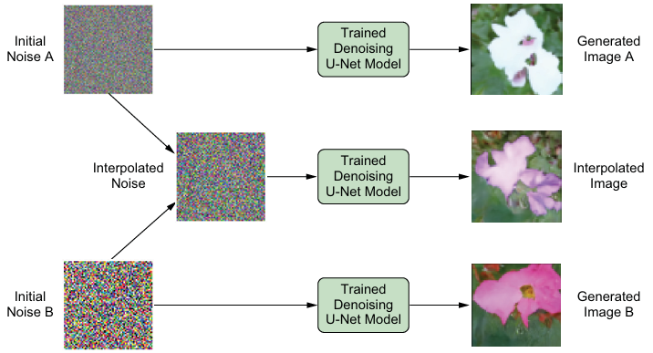
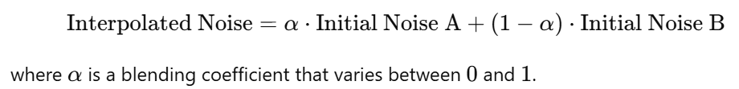
Noise Tensor Interpolation
NOTE: Linear interpolation is shown here; alternative formulations (e.g., sine/cosine, spherical interpolation, etc.) are also possible.

Slide 29
Noise Tensor Interpolation
Blending two noise seeds produces a smooth visual transition between two different flowers.
def interpolate(self, model, a_idx, b_idx, ...):
# Generates a batch of pure Gaussian noise
image0 = torch.randn((batch_size, model.in_channels, model.sample_size, model.sample_size), generator=generator,).to(device)
# Prepare container for interpolation → this will store interpolated noise tensor(s)
image = torch.zeros((batch_size, model.in_channels, model.sample_size, model.sample_size)).to(device)
# Pick two initial noise tensors
a, b = image0[a_idx], image0[b_idx]
# Create 10 interpolated noise tensors by placing different weights on the 2 noise tensors
for i in range(10):
ab=torch.sin(torch.tensor(0.5*math.pi*(0.05+i/10)))*a + torch.cos(torch.tensor(0.5*math.pi*(0.05+i/10)))*b
image[i]=ab
...
# Generate images by iteratively denoising the interpolated noise tensors
for t in tqdm(self.timesteps):
model_output = model(image, t)["sample"]
image = self.step(model_output, t, image, eta, ...)
...
return image

Slide 30
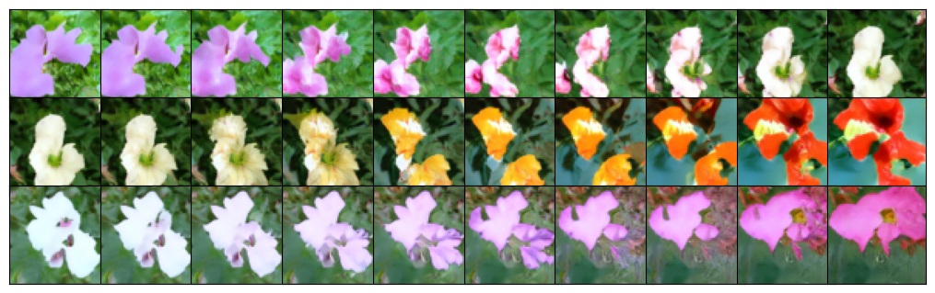
Noise Tensor Interpolation

Slide 31
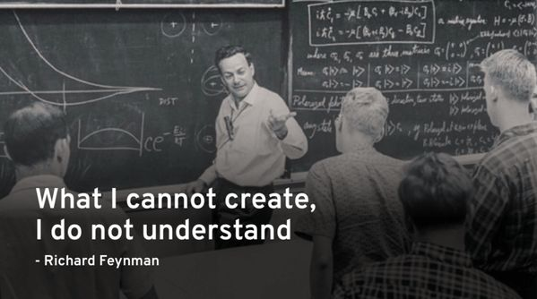

Slide 32
Lab Exercises
01
Training set grid (2×5)
Plot 10 images from the training dataset in a 2×5 grid.
Hint: use next(iter(train_dataloader))['input'] and plt.subplot(2, 5, i+1). Remember to permute from (C,H,W) to (H,W,C) before imshow.
02
Forward diffusion grid (4×5)
Modify the code for applying forward diffusion to flower images. Use four images from the training set to generate images in time steps 0, 250, 500, 750 and 1,000 . Plot them in a 4×5 grid.
Hint: use noise_scheduler.add_noise() for timesteps [250, 500, 750, 1000]. The 4×5 grid has 4 rows (one per image) and 5 columns (one per timestep).
03
Generation with seed 42
Modify the code for image generation with the trained denoising U-Net, and change the random seed to 42 . Keep the rest of the code the same. Rerun the code to see what the generated images look like.
Hint: only change generator = torch.manual_seed(42). Everything else stays the same. You should get 10 completely different flowers.
04
Interpolate tensors 3 and 4
Modify the code for interpolating initial noise tensors to use the third and fourth initial noise tensors to generate 10 interpolated images. Keep the rest of the code the same (in particular, keep the random state to 100). Rerun the code to see what the generated images look like.
Hint: indices are 0-based — tensor 3 = a_idx=2, tensor 4 = b_idx=3. The transition should be smoother as adjacent tensors are more similar.

Slide 33
Ex 1
Solution 1
Training set grid (2×5)
❓ Plot 10 images from the training dataset in a 2×5 grid.
import matplotlib.pyplot as plt
import torch
it = iter(train_dataloader)
batch1 = next(it)["input"] # 4 images
batch2 = next(it)["input"] # 4 more images
batch3 = next(it)["input"] # 4 more — take first 2
batch = torch.cat([batch1, batch2, batch3], dim=0)[:10] # (10, 3, 64, 64)
plt.figure(figsize=(10, 4), dpi=100)
for i in range(10):
plt.subplot(2, 5, i + 1) # 2 rows, 5 cols, 1-based index
img = batch[i].permute(1, 2, 0) # (C, H, W) → (H, W, C)
plt.imshow(torch.clip(img, 0, 1)) # clip to valid [0, 1] range
plt.axis("off")
plt.tight_layout()
plt.show()
💡Keep the original batch size and concatenate multiple batches to manually form a batch of 10 images.

Slide 34
Ex 1
Solution 2
Training set grid (2×5)
❓ Plot 10 images from the training dataset in a 2×5 grid.
import matplotlib.pyplot as plt
import torch
from torch.utils.data import DataLoader
# Create a temporary dataloader with batch_size=10
dataloader_10 = DataLoader(dataset, batch_size=10, shuffle=True)
batch = next(iter(dataloader_10))["input"] # shape: (10, 3, 64, 64)
plt.figure(figsize=(10, 4), dpi=100)
for i in range(10):
plt.subplot(2, 5, i + 1) # 2 rows, 5 cols, 1-based index
img = batch[i].permute(1, 2, 0) # (C, H, W) → (H, W, C)
plt.imshow(torch.clip(img, 0, 1)) # clip to valid [0, 1] range
plt.axis("off")
plt.tight_layout()
plt.show()
💡Increase the batch_size to 10 so you directly get 10 images in a single batch.

Slide 35
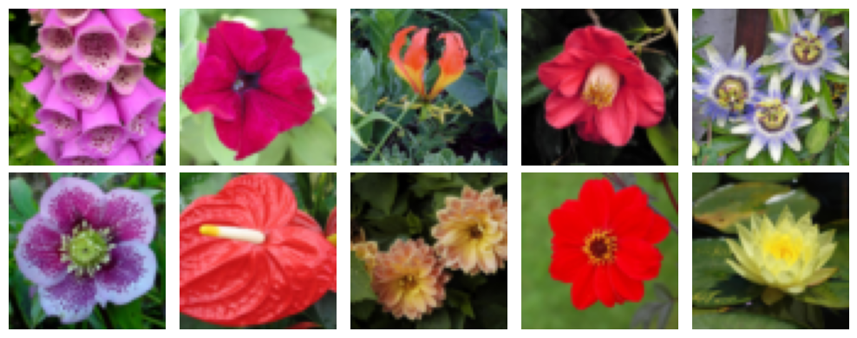
Ex 1
Training set grid (2×5)
❓ Plot 10 images from the training dataset in a 2×5 grid.

Slide 36
Ex 2
Forward diffusion grid (4×5)
❓ Modify the code for applying forward diffusion to flower images. Use four images from the training set to generate images in time steps 0 , 250 , 500 , 750 , and 1,000 . Plot them in a 4×5 grid.
import torch
import matplotlib.pyplot as plt
# Get 4 clean flower images → shape: (4, 3, 64, 64)
batch = next(iter(train_dataloader))["input"]
imgs = batch.permute(0, 2, 3, 1) # (4, 64, 64, 3) channel-last
timesteps = [0, 250, 500, 750, 1000] # 5 columns
plt.figure(figsize=(10, 8), dpi=100)
for row in range(4): # one row per image
img = imgs[row] # (64, 64, 3)
for col, t in enumerate(timesteps): # one col per timestep
subplot_idx = row * 5 + col + 1 # 1-based index
plt.subplot(4, 5, subplot_idx)
if t == 0:
# t=0: show the original clean image
noisy = img
else:
noisy = noise_scheduler.add_noise(img, torch.randn(img.shape), torch.tensor([t - 1]).long())
plt.imshow(torch.clip(noisy, 0, 1))
plt.axis("off")
if row == 0:
plt.title(f"t={t}", fontsize=10) # label columns on top row only
plt.tight_layout()
plt.show()

Slide 37
Ex 2
Forward diffusion grid (4×5)
❓ Modify the code for applying forward diffusion to flower images. Use four images from the training set to generate images in time steps 0 , 250 , 500 , 750 , and 1,000 . Plot them in a 4×5 grid.
Lab code (original)
Exercise 2 (modified)
Timesteps
200, 400, 600, 800, 1000
0 (clean), 250, 500, 750, 1000
Grid shape
1×6 (1 row, 6 cols)
4×5 (4 rows, 5 cols)
Images
1 composite image (4 stacked)
4 separate images (one per row)
Index calc
plt.subplot(1, 6, i+1)
plt.subplot(4, 5, row*5 + col+1)
t=0 column
No t=0 — starts at t=200
First column = original clean image

Slide 38
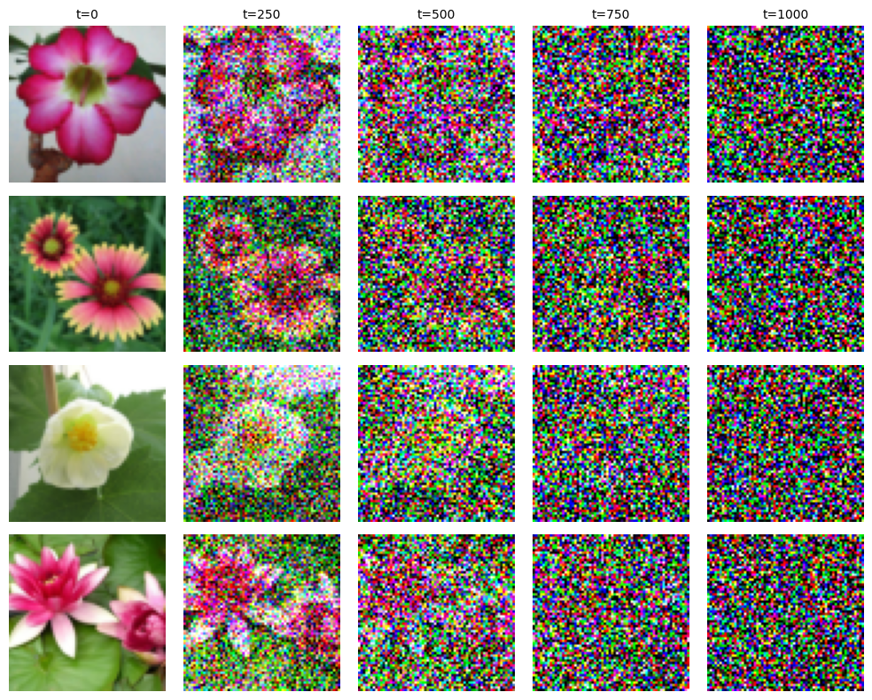
Ex 2
Forward diffusion grid (4×5)
❓ Modify the code for applying forward diffusion to flower images. Use four images from the training set to generate images in time steps 0 , 250 , 500 , 750 , and 1,000 . Plot them in a 4×5 grid.

Slide 39
Ex 3
Generation with seed 42
❓ Modify the code for image generation with the trained denoising U-Net, and change the random seed to 42. Keep the rest of the code the same. Rerun the code to see what the generated images look like..
import torch
import matplotlib.pyplot as plt
# Load trained weights
sd = torch.load("files/diffusion.pth", weights_only=True)
model.load_state_dict(sd)
with torch.no_grad():
generator = torch.manual_seed(42) # ← ONLY CHANGE: 100 → 42
generated_images, imgs = noise_scheduler.generate(model, device=device, num_inference_steps=50,
generator=generator, eta=0, use_clipped_model_output=True, batch_size=10)
imgnp = generated_images
plt.figure(figsize=(10, 4), dpi=100)
for i in range(10):
ax = plt.subplot(2, 5, i + 1)
plt.imshow(imgnp[i])
plt.axis("off")
plt.tight_layout()
plt.show()

Slide 40
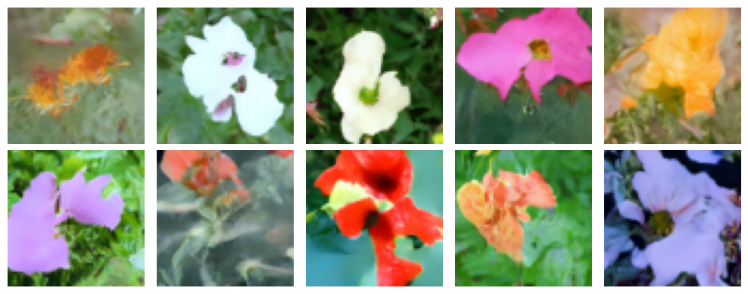
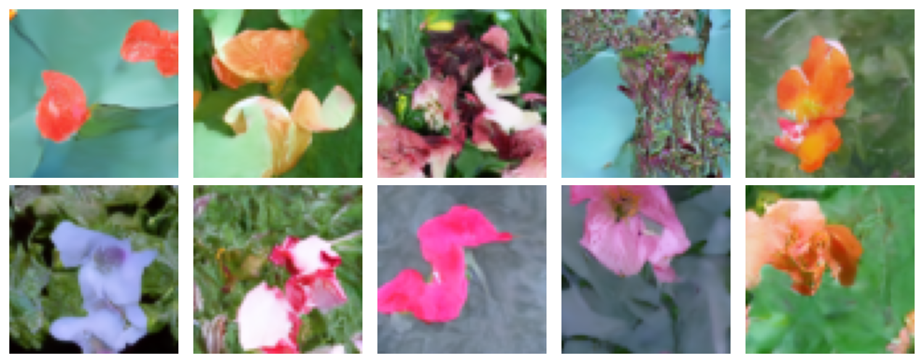
Ex 3
Generation with seed 42
❓ Modify the code for image generation with the trained denoising U-Net, and change the random seed to 42. Keep the rest of the code the same. Rerun the code to see what the generated images look like.
seed 100
seed 42
Expected observations
▸ All 10 flowers look completely different from seed 100.
▸ Running the same code again produces identical results (deterministic).

Slide 41


Slide 42
Ex 4
Interpolate tensors 3 and 4
❓ Modify the code for interpolating initial noise tensors to use the third and fourth initial noise tensors to generate 10 interpolated images. Keep the rest of the code the same (in particular, keep the random state to 100). Rerun the code to see what the generated images look like.
import torch
import matplotlib.pyplot as plt
with torch.no_grad():
generator = torch.manual_seed(100) # same seed as in laboratory
generated_images = noise_scheduler.interpolate(
model,
2, # a_idx=2 → "third" tensor (0-based)
3, # b_idx=3 → "fourth" tensor (0-based)
num_inference_steps=50,
generator=generator,
eta=0, # deterministic
use_clipped_model_output=True,
batch_size=10 # 10 interpolated images
)
imgnp = generated_images
plt.figure(figsize=(10, 4), dpi=100)
for i in range(10):
ax = plt.subplot(1, 10, i + 1)
plt.imshow(imgnp[i])
plt.axis("off")
plt.tight_layout()
plt.show()

Slide 43
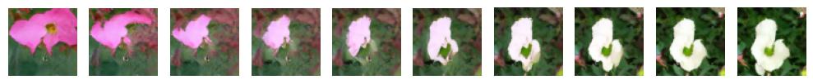
Ex 4
Interpolate tensors 3 and 4
❓ Modify the code for interpolating initial noise tensors to use the third and fourth initial noise tensors to generate 10 interpolated images. Keep the rest of the code the same (in particular, keep the random state to 100). Rerun the code to see what the generated images look like.
Expected observations
Left image = image 4 from section 4.1: The leftmost of the 10 interpolated images should match the fourth generated flower (seed 100, index 2).
Right image = image 3 from section 4.1: The rightmost matches the third generated flower (seed 100, index 3).
Smoother transition than 1→7: Tensors 2 and 3 are adjacent in the noise sequence — their blend is typically more gradual than the 1→7 blend used in the lab.
All 10 are valid flower images: Even the middle blended images look like plausible flowers, not just a naive pixel average. The U-Net decodes any valid noise tensor to a coherent flower.

Slide 44


Slide 45
Thank you !

